Slide 1


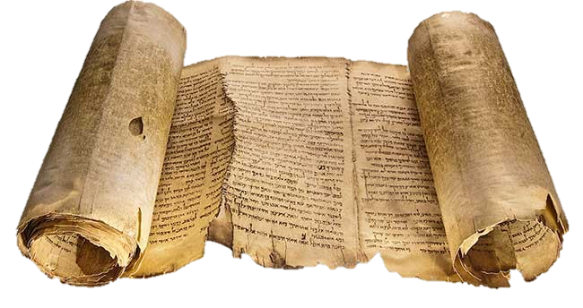
Hermeneutical Considerations for Evangelism and Reconciliation in the Land
Reading the
Bible in the
Right Direction
© Tim M. Sigler, PhD

Slide 2
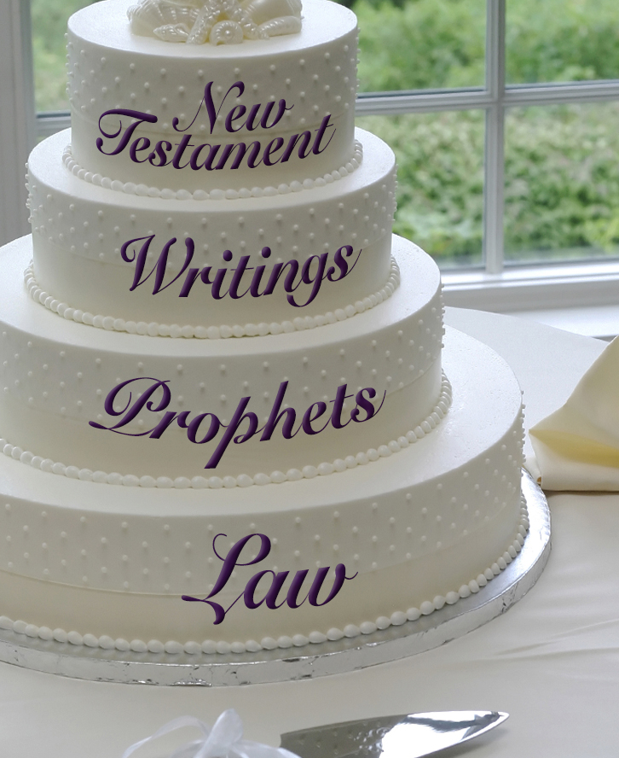
The Wedding Cake Metaphor

Slide 3
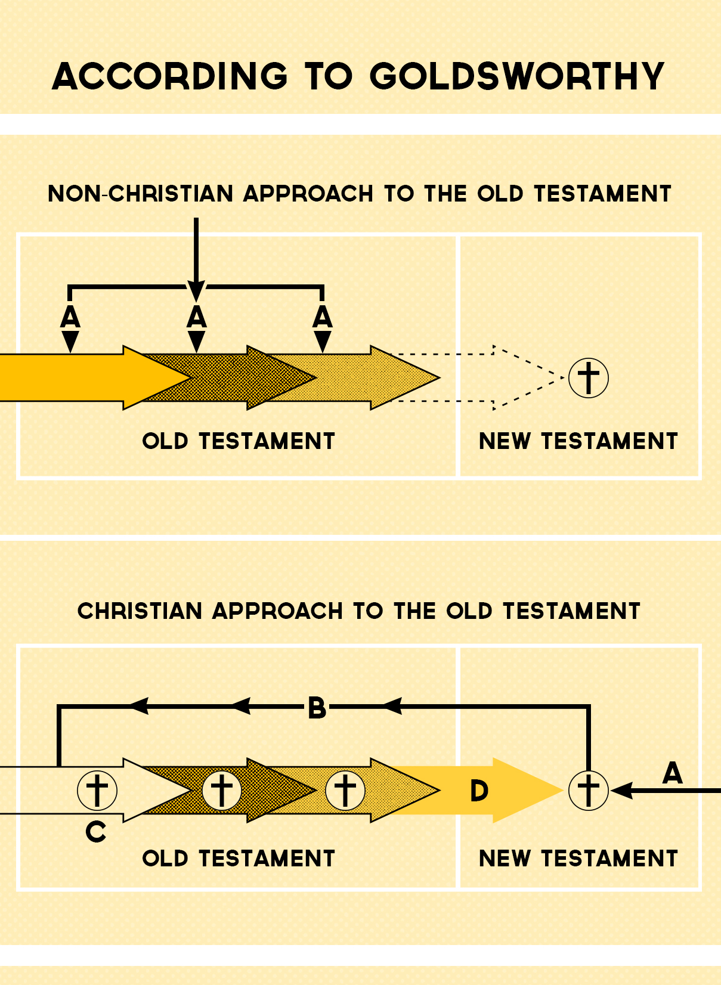

Slide 4
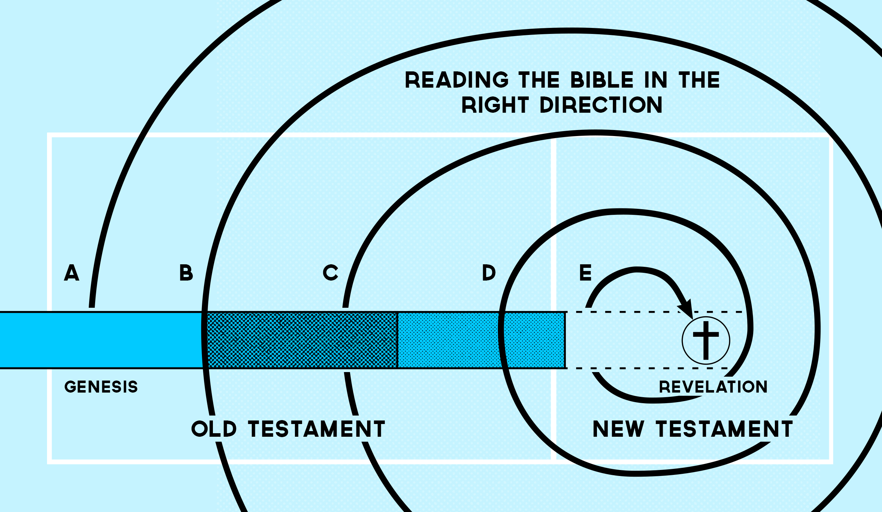

Slide 5
How Does Reading in the Right Direction Help Us Better Understand the Bible?
Israel
Church
Remnant
Natural Branches
Cut Off Branches
Grafted In Branches
1. Reading in the right direction recognizes Israel as Israel, not the church.

Slide 6
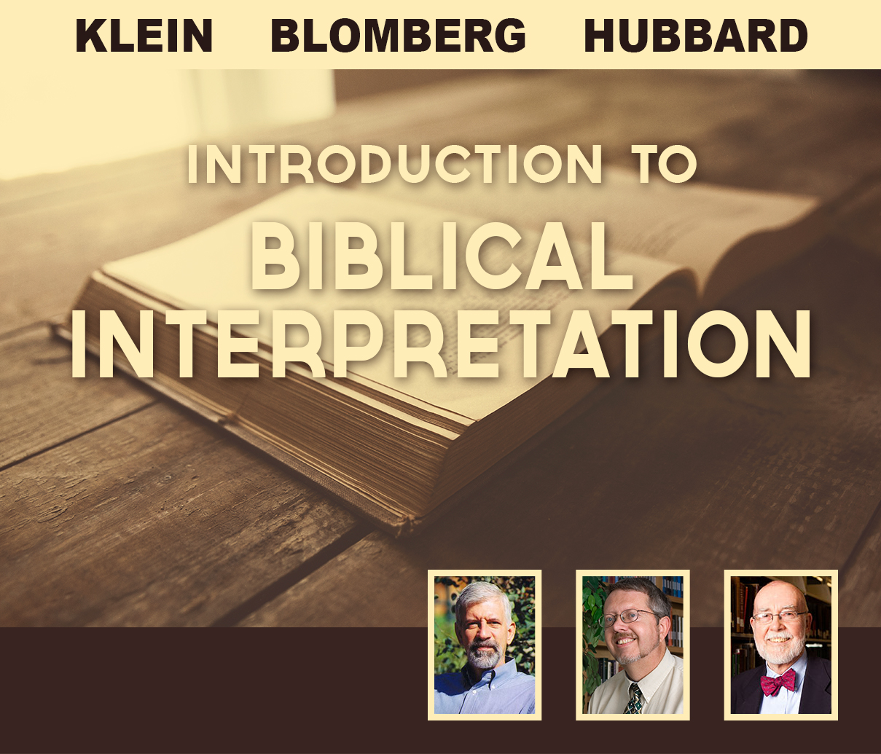

Slide 7
“In fact Paul specifically quotes from God’s initial covenant with Abraham (Gen. 12:3b)—’All nations will be blessed through you’ (Gal. 3:8)—as part of the ‘gospel,’ which foresaw Gentiles coming to faith in Christ. So it seems highly incongruous to take the first half of the verse out of Genesis and assume that “Israel” still means a literal Jewish nation. Although it is popular among conservative American Christians to cite Genesis 12:3a (‘I will bless those who bless you, and whoever curses you I will curse’) as a reason for supporting the current state of Israel, legitimate principles of application would seem to require that the ‘you’ in this text now refers to the Church of Jesus Christ. In other words, God will bless those who support Christian causes and will not bless those who attack them.”
—Klein, Blomberg and Hubbard, Introduction to Biblical Interpretation

Slide 8

The standard canonical narrative turns on four key episodes:
• God’s intention to consummate the first parents whom God has created
• the fall
• Christ’s incarnation and the inauguration of the church
• final consummation
Soulen’s concern:
This “completely neglects the Hebrew Scriptures, with the exception of Genesis 1–3!”
R. Kendall Soulen Director of the Master of Theological Studies Program; Professor of Systematic Theology
Wesley Theological Seminary
Washington, DC

Slide 9
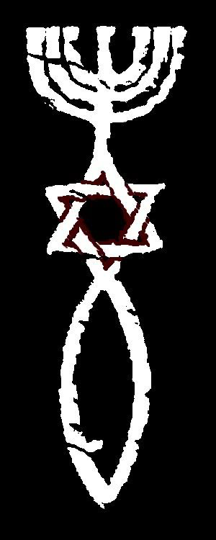
How Does Reading in the Right Direction Help Us Better Understand the Bible?
2. Reading in the right direction celebrates both Jews and Gentiles in God’s redemptive plan.

Slide 10
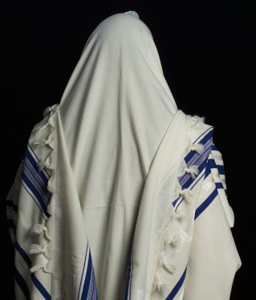
How Does Reading in the Right Direction Help Us Better Understand the Bible?
3. Reading in the right direction appreciates the Jewishness of Jesus and the gospel

Slide 11
How Does Reading in the Right Direction Help Us Better Understand the Bible?
Paul, a bondservant of Jesus Christ, called to be an apostle, separated to the gospel of God which He promised before through His prophets in the Holy Scriptures, concerning His Son Jesus Christ our Lord, who was born of the seed of David according to the flesh, and declared to be the Son of God with power according to the Spirit of holiness, by the resurrection from the dead. (Rom. 1:1–4)

Slide 12
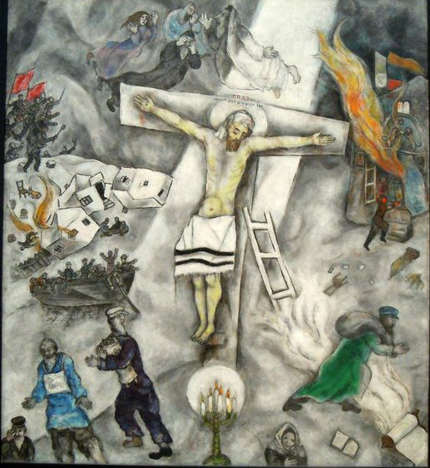
Unfortunately, many Christians today seem to overlook Jesus’ identity as the son of David and His connection to the Tribe of Judah and the Jewish people as a whole.
The White Crucifixion is a painting by Marc Chagall. It was painted in 1938 after Chagall had visited Europe and can be viewed at the Art Institute of Chicago.

Slide 13
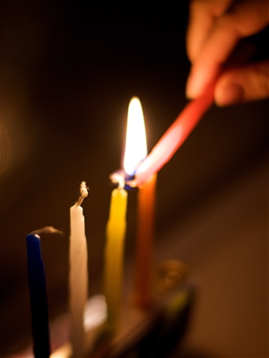
How Does Reading in the Right Direction Help Us Better Understand the Bible?
4. Reading in the right direction recognizes God’s faithfulness in preserving a Jewish remnant in every age and anticipates the restoration of the Jewish people.

Slide 14
For you are a holy people to the LORD your God; the LORD your God has chosen you to be a people for Himself, a special treasure above all the peoples on the face of the earth. The LORD did not set His love on you nor choose you because you were more in number than any other people, for you were the least of all peoples; but because the LORD loves you, and because He would keep the oath which He swore to your fathers, the LORD has brought you out with a mighty hand, and redeemed you from the house of bondage, from the hand of Pharaoh king of Egypt. (Deut. 7:6-8)

Slide 15
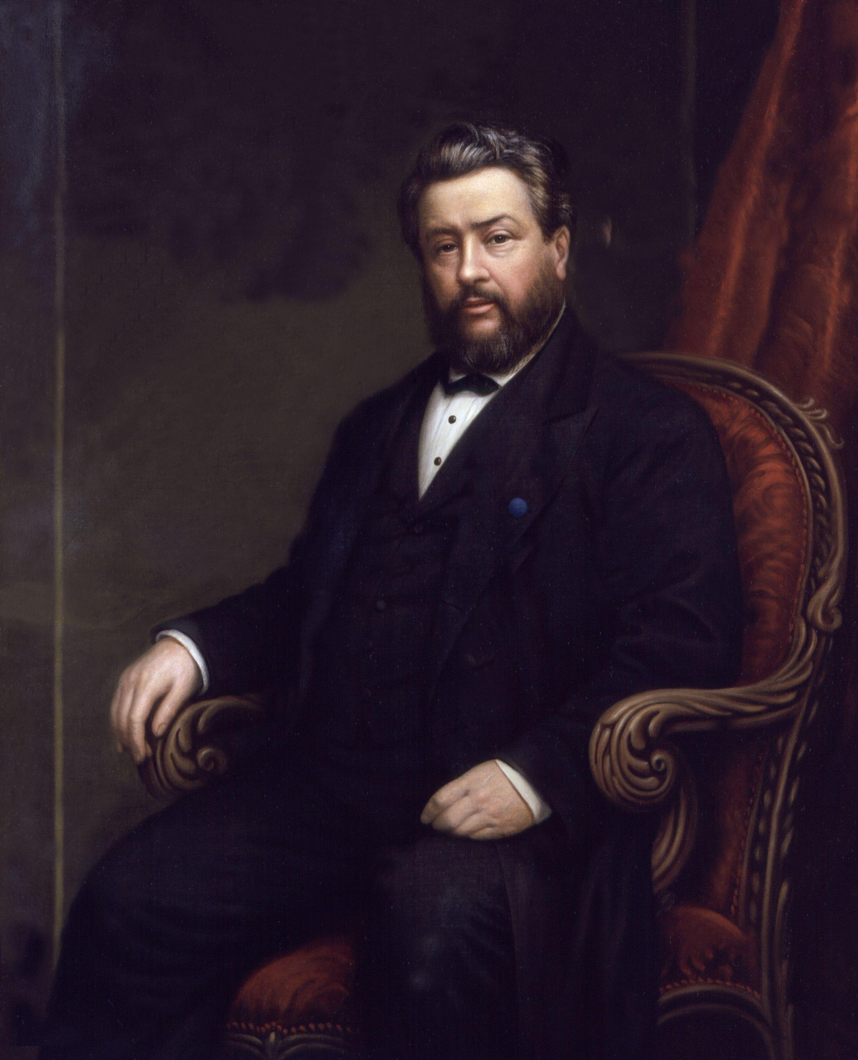
Charles Haddon Spurgeon
“There is to be a political restoration of the Jews.” Based upon his study of the Scriptures, he preached, “Israel is now blotted out from the map of nations; her sons are scattered far and wide; her daughters mourn beside all the rivers of the earth. Her sacred song is hushed; no king reigns in Jerusalem; she brings forth no governors among her tribes. But she is to be restored; she is to be restored ‘as from the dead.’”

Slide 16
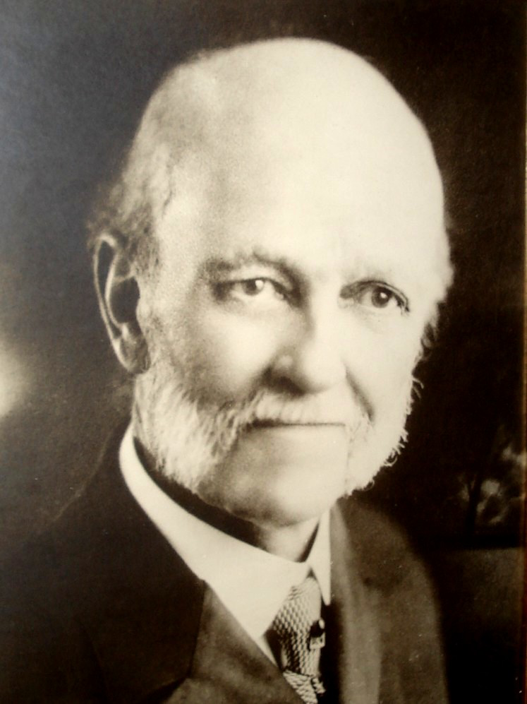
“Israel is to be restored!”
William E. Blackstone in Jesus Is Coming
1878

Slide 17

How Does Reading in the Right Direction Help Us Better Understand the Bible?
5. Reading the Bible in the right direction protects us from the arrogance against which Paul warns.

Slide 18
For if the firstfruit is holy, the lump is also holy; and if the root is holy, so are the branches. And if some of the branches were broken off, and you, being a wild olive tree, were grafted in among them, and with them became a partaker of the root and fatness of the olive tree, do not boast against the branches. But if you do boast, remember that you do not support the root, but the root supports you. You will say then, “Branches were broken off that I might be grafted in.” Well said. Because of unbelief they were broken off, and you stand by faith. Do not be haughty, but fear. For if God did not spare the natural branches, He may not spare you either. Therefore consider the goodness and severity of God: on those who fell, severity; but toward you, goodness, if you continue in His goodness. Otherwise you also will be cut off. And they also, if they do not continue in unbelief, will be grafted in, for God is able to graft them in again. For if you were cut out of the olive tree which is wild by nature, and were grafted contrary to nature into a cultivated olive tree, how much more will these, who are natural branches, be grafted into their own olive tree? (Rom. 11:16-24)

Slide 19
Gentile-Christian boasting over Jews is probably not the result of anti-Semitism generally, but of a mistaken reading of the course of salvation history. These Gentile Christians appear to have concluded that the unprecedented degree in which the doors of salvation were open to Gentiles after the coming of Christ meant the closing of those same doors to Jews. At the same time, these Gentile believers were apparently convinced that they belonged to a new people of God that had simply replaced Israel. Those [Jews] who believed, they apparently assumed, could become part of their community and on their terms (see 14:1–15:13). It is to this kind of attitude that Paul responds in vv. 18b-22.
—Douglas Moo, Romans (NICNT), 703-4.

Slide 20
Hermeneutical context and starting point for Evangelism and Reconciliation in The Land :
• Tells the story as it is told in Scripture
• Israel’s role in the story is not an optional component
• Not dependent on the righteousness, justice and equity of Israel’s government
• Does not ignore the plight of Palestinians

Slide 21
Hermeneutical Considerations for Evangelism and Reconciliation in the Land
Reading the
Bible in the
Right Direction
© Tim M. Sigler, PhD

